Slide 1
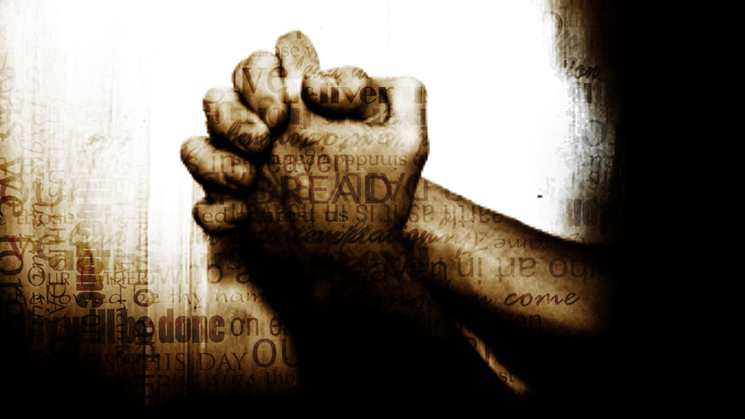
Writing Prayers
Mrs. Hedges

Slide 2
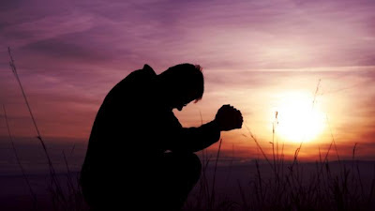
Prayer Definition
In its simplest definition prayer is a conversation between the one who is praying and the one to whom those prayers is directed. For the writer this must always be taken into account.
Prayer can take many forms, and encompass the whole range of poetic and literary styles. It can be a cry for help or a cry of joy.

Slide 3
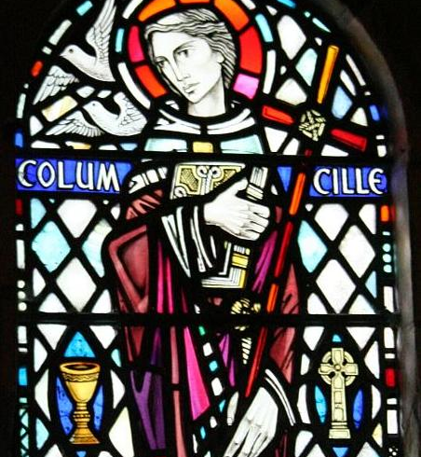
Structure of the Prayer
If we are going to be creative in our prayers then I do not feel that there should be too many hard and fast rules about the format and content.
For those who are strangers to poetry, don’t let this put you off. I don’t think Saint Columba was renowned as a poet, but he knew how to praise his God.
Alone with none but thee, my God, I journey on my way. What need I fear, when thou art near O king of night and day? More safe am I within thy hand Than if a host did round me stand. (Columba, c.521 - 97)

Slide 4
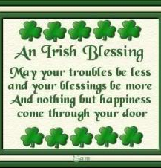
Free Verse or Rhyme Prayer
Free verse or rhyme, structured or not let the Spirit take you where He will. Allow your inspiration to paint pictures with words.
Deep peace of the running wave to you, Deep peace of the flowing air to you, Deep peace of the quiet earth to you, Deep peace of the shining stars to you, Deep peace of the Son of Peace to you, forever. (Old Celtic prayer)

Slide 5
Who is the Prayer For? Why Are You Writing It?
Most importantly, remember to whom the prayer is directed and the congregation or individuals who are being asked to join their thoughts with your words. Make sure that your language is accessible, your theology sound and let your personality mold the prayer that you write.
When you have written it, ask yourself the question 'If I had come across this prayer in a book, would I have used it?' If the answer is 'No!' then re-examine what you have written and see if you can refine the language, change a word or two, structure the lines better.

Slide 6
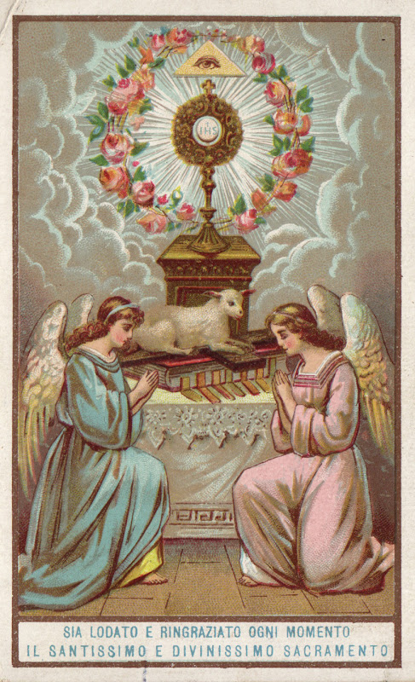
Content in the Prayers
Within the context of our collective worship there are certain elements that it would seem right to include, in order that our prayers are not seen to be too narrow in their aspirations. These can be represented by the well-used acronym A.C.T.S.S
Adoration
Confession
Thanksgiving
Supplication
Silence

Slide 7
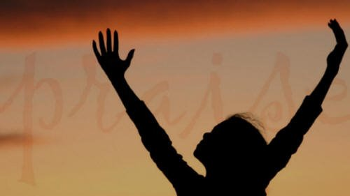
Adoration
Our prayer of adoration is one that is centered entirely on God. It is our expression of praise for all that God is - His holiness, majesty, love and greatness.
It’s that mountaintop experience of being in the presence of the Creator of all that you see around you, or sitting through a truly wonderful performance of a sacred work which has transported your soul to another plain.
Adoration comes from the heart, from our emotions; it’s an expression of our inmost feelings

Slide 8
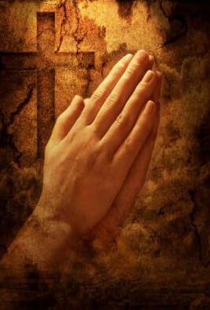
Adoration Prayer
Every creature, every plant every rock and grain of sand proclaims the glory of its Creator worships through colour, shape scent and form. A multi-sensory song of praise. Creator God, may we join with the whole of your creation in praising you, our Creator through the fragrance and melody of our lives

Slide 9
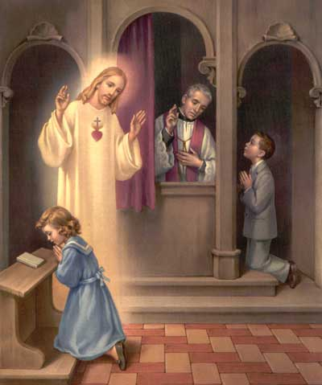
Confession Prayer
An awareness of God’s presence within our worship naturally leads on to a feeling of our own unworthiness. In confession we acknowledge what we are and ask for forgiveness.
If these prayers are part of an act of public worship then it is appropriate to express the Christian conviction that we all share in the sin of humankind.
Any prayer of confession should properly express our belief that God offers the promise of forgiveness.

Slide 10
Confession Prayer
is all the heart can bear to say aloud. It is only you who can read and understand the language of our hearts Only you who can translate our 'sorry' into the prayer we would have prayed if we had the words within us. Then you forgive and having forgiven surround us in an embrace of love drawing us close to your heart as it was always meant to be. Thank you, Loving Father that you listen to hearts as well as voices Thank you.
Loving Father all the fancy words in the world expressed in eloquent prose decorated with emotion spoken with conviction cannot compete with a heartfelt 'sorry' when all other words fail. There are times when we are all too aware of our limitations conscious of sin and the distance it creates between us. Sometimes 'sorry'

Slide 11
Thanksgiving Prayer
Often lost within the package of prayer offered within worship is thanksgiving. It gets confused with adoration or simply ignored as prayers focus on intercession.
It is only right and proper that we should thank God for all that he has done. For the beauty of this world which he created, for the birth, life, death and resurrection of Jesus Christ, the promise of the Holy Spirit, his continuing creativity in the world today and for the Church - his body here on earth.

Slide 12
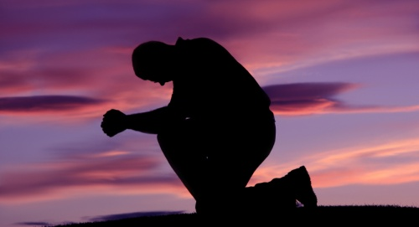
Thanksgiving Prayer
After the storm a rainbow skillfully painted from the spectrum of colours contained in your glorious palette. Warm colours encircling us embracing this earth with a promise a reminder of your covenant with all of your creation. Such love eternal and everlasting. Thank you, Creating God for the beauty of the rainbow and the beauty of your love For all that you have made and are going to make

Slide 13
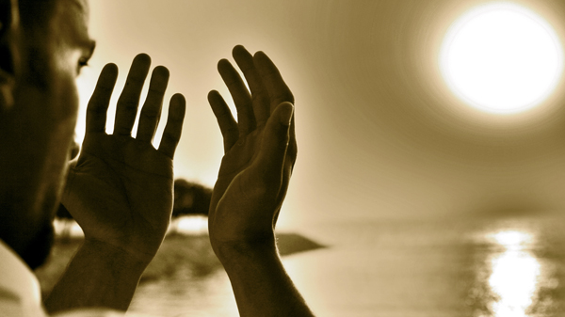
Supplication of the Prayer
Is the asking part of our prayers, the requests for healing, justice, peace, comfort or whatever is the need of the moment. This can take many forms, but must also take into account that we might actually be part of the answer to our own prayer!

Slide 14
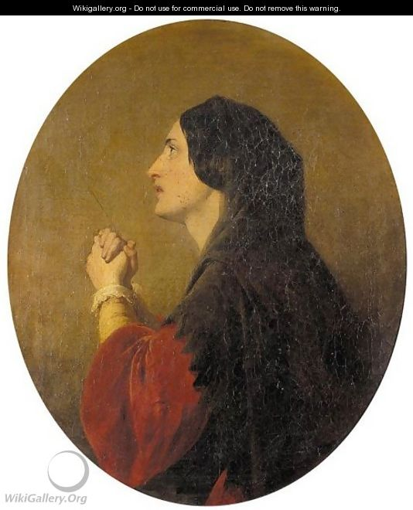
Supplication Example
God of love Hear the cry of those who yearn for love Fractured families, broken homes Neglected, unwanted, alone God of love ALL: hear our prayer
God of justice Hear the cry of those who yearn for justice Persecuted and oppressed Exploited, ill-treated, broken God of justice ALL: hear our prayer

Slide 15
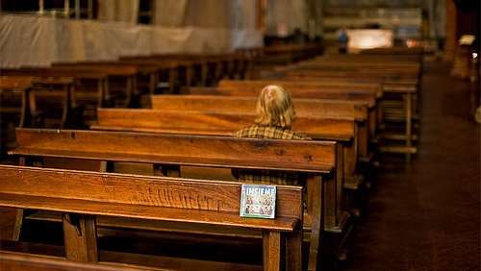
Silence in the Prayer
Silence is important, in that it allows us time to digest all that has been said through prayer. It gives us precious time within worship to let our hearts talk and our mouths stay silent.
As David Adam says ‘It is not an empty time but a God-filled time when we open ourselves up to him.
How do you write silence into a prayer? Well, that’s up to the individual writer to decide. If you are writing a liturgy, or responsive prayer then it is fairly straightforward.
Shall we spend a moment or two in quiet reflection. For love, freely given to all (pause) For wholeness, the healing touch for broken lives (pause) For Salvation, for being made right again with God (pause)

Slide 16
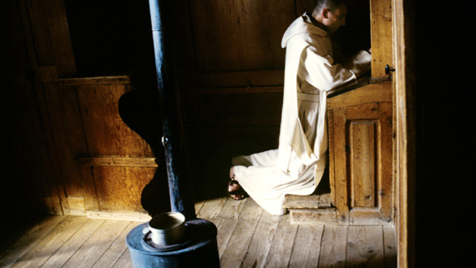
Simple Pause in Prayer
But even within a simple prayer there can be time to pause, reflect and respond before proceeding. No-one said that a prayer was a continual stream of words ending in ‘Amen’.
Thank you Lord God for the opportunity of worship for the freedom to be amongst your family meeting together in your house and in the warmth of your embrace
(pause)
Thank you that in worship we can put aside the uncertainties of this world and rest upon the certainties of the Kingdom for your promises are not changeable as those of a politician might be but immovable and eternal
(pause)

Slide 17
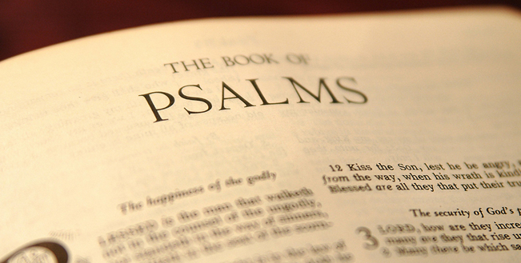
Conclusion
I hope you feel inspired to write a prayer or prayers, it will be an uplifting exercise –simply the act of taking words and using them carefully to express your own thoughts and feelings.
Don’t be afraid that you are producing something too personal. Remember David the Psalmist. Read some of his prayers and you’ll realize soon enough that he was happy to share his ups and downs, the pits and the mountaintops with anyone. And thousands of years later people are still inspired by his words, touched by his humility and faith.

